Slide 1

Introduction to Arduino
Class 1

Slide 2


Step1. Arduino IDE
Before diving into the work of wiring and programing, let’s get well prepared on your PC
Arduino IDE is a powerful tool to program all Arduino hardware products
A place where you can write your Arduino Code, compile it and uploading it to your Arduino boards
Download (may take a long time to get access to the website,
change DNS to 8.8.8.8 if necessary)
Official Website: https://www.arduino.cc/
Not https://www.arduino.com

Slide 3


Click on ‘Downloads’
Scroll the webpage and find ’Arduino IDE’
Get the installation package accordingly

Slide 4

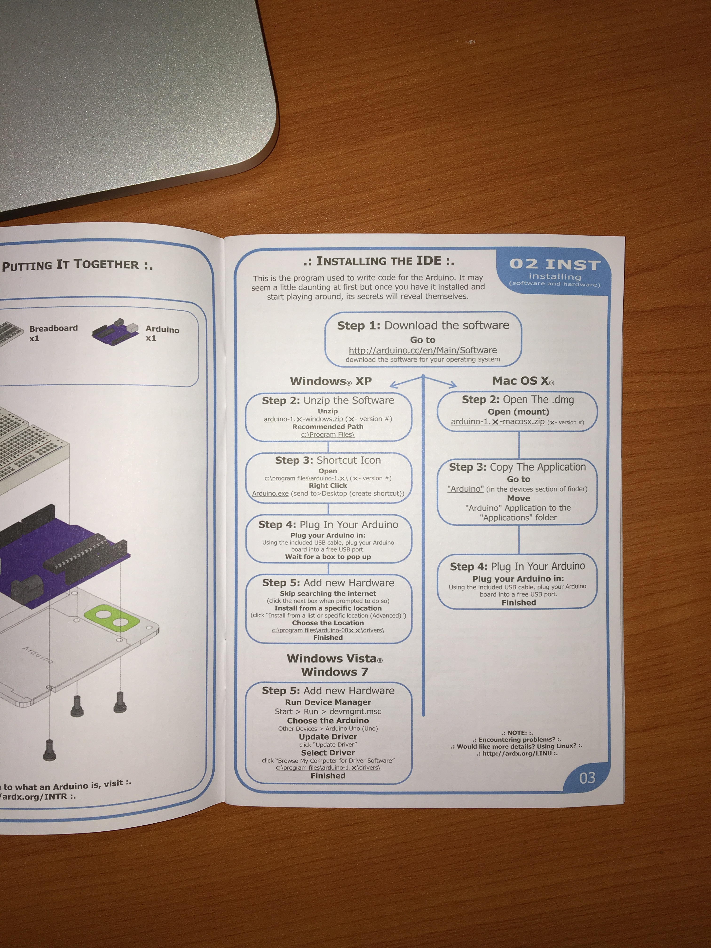
Download Process for Mac
Download Process for Windows
If something still goes wrong
contact me ASAP
Then just follow the instructions and get the IDE

Slide 5
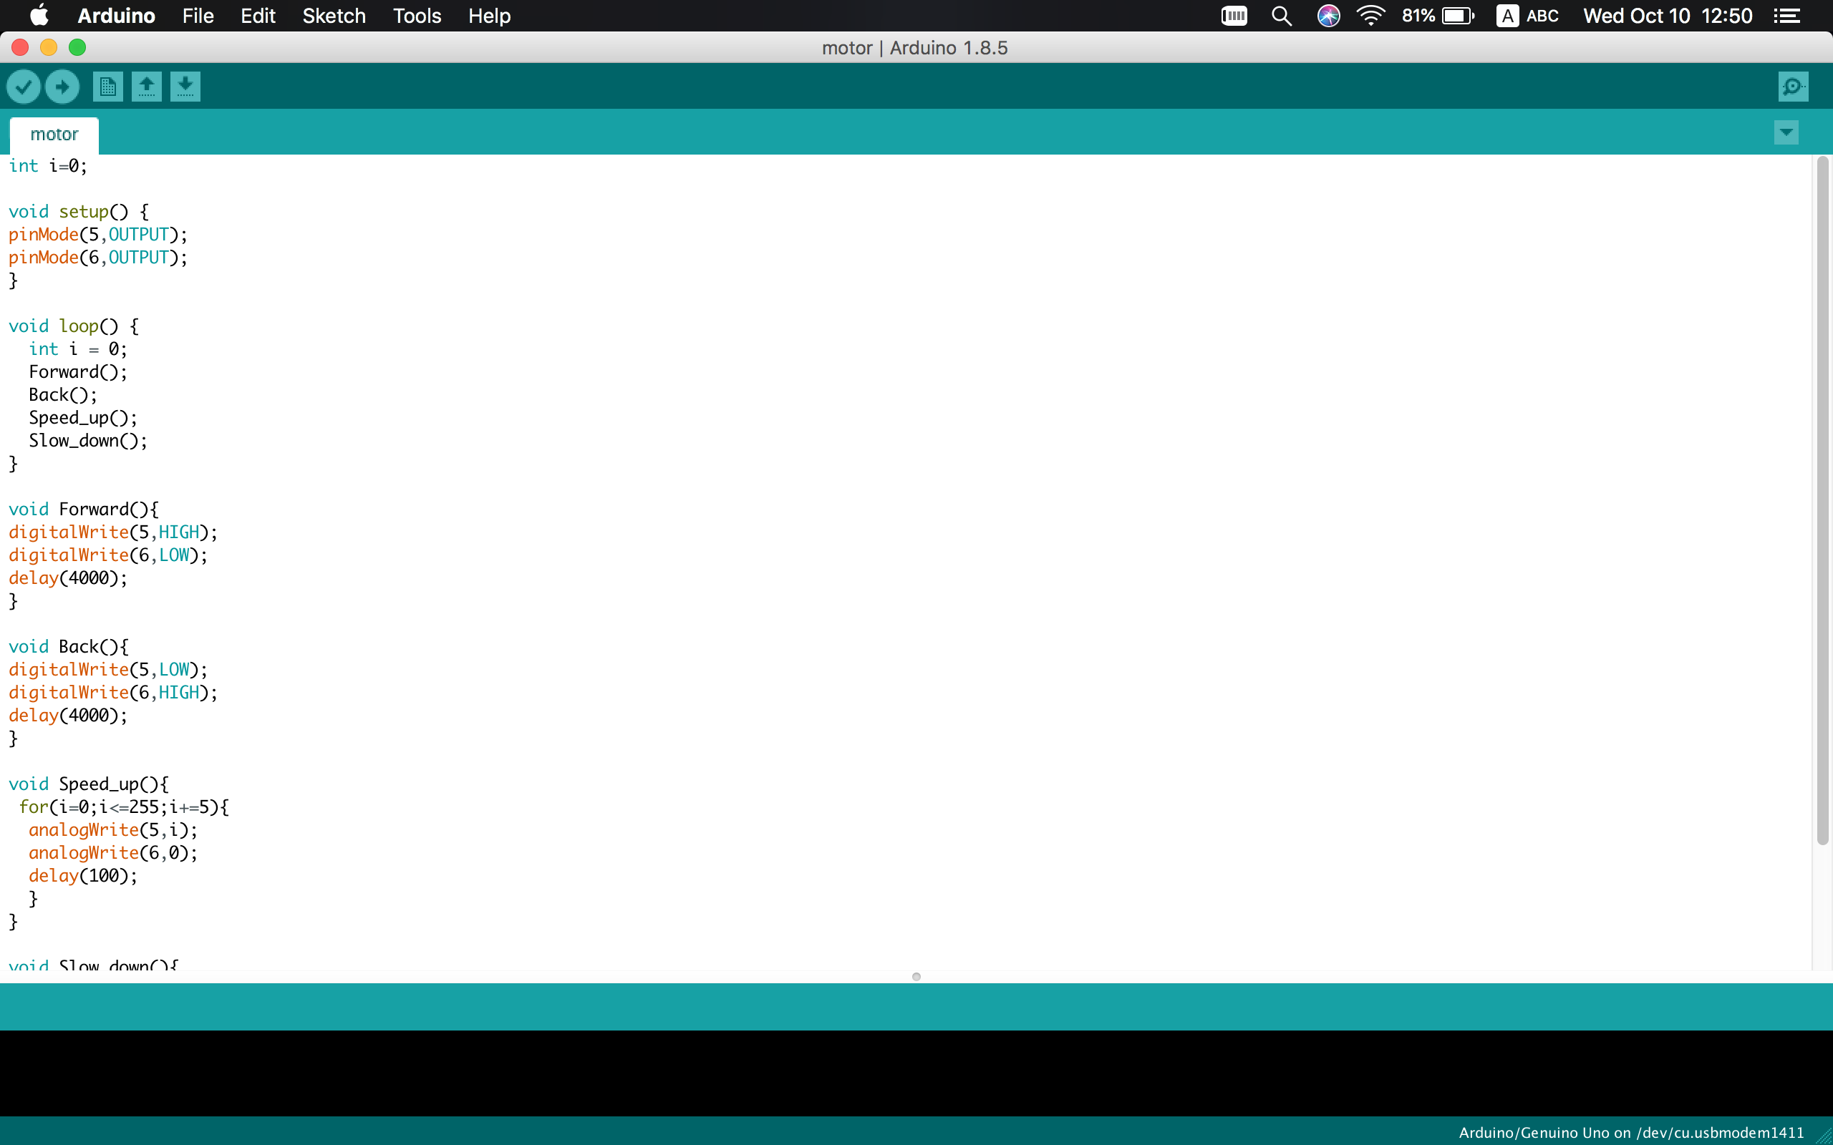
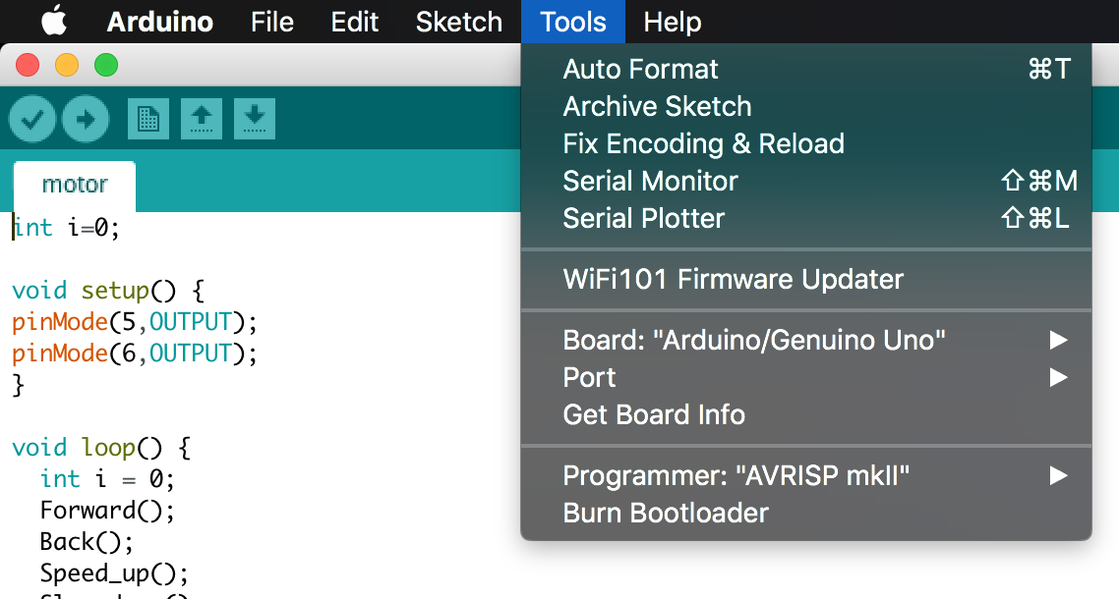
Step2. USB drive (optional)
Some PCs do not have USB drive software in advance
This may lead to the problem that your PC can not identify the Arduino hardware you plug in
It is necessary to have one before your start uploading the program.
Check if you need to download a USB drive:
1. Open Arduino IDE
2. Connect to Arduino Uno with USB Wire
3. Click on ‘Tools’ and move to ‘Port’

Slide 6
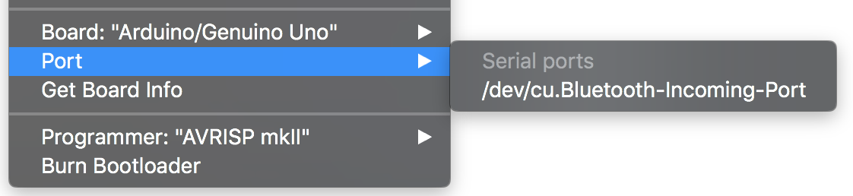
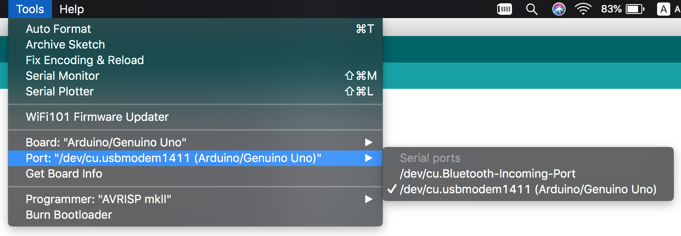
If your port does not show a ‘USB-Port’, then perhaps:
The USB wire does not work, or
A USB drive on your PC is needed
Just get one from the Internet
If your Port shows a USB connection with
Arduino Board, then you are already done.

Slide 7

Topic 1 Breadboard & Wire Connection
？
？
？
？
？
Breadboard = Bread + Board???
？
Breadboard = Blackboard’s little brother???
Breadboard is a construction base to build temporary electric circuits.
A frequently used tool to design circuits before soldering wires between actual electronic components
In the whole semester & in the following hands-on practices in the future, we will use this stuff to build our circuit.

Slide 8
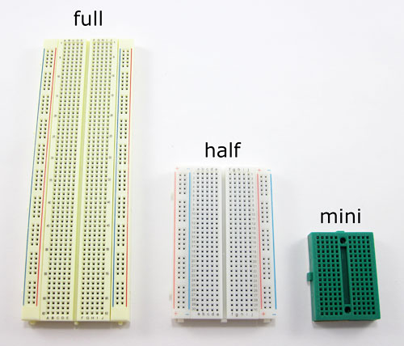
Size of different Breadboard

Slide 9


Slide 10
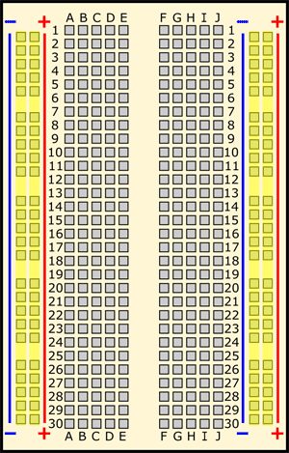

Slide 11
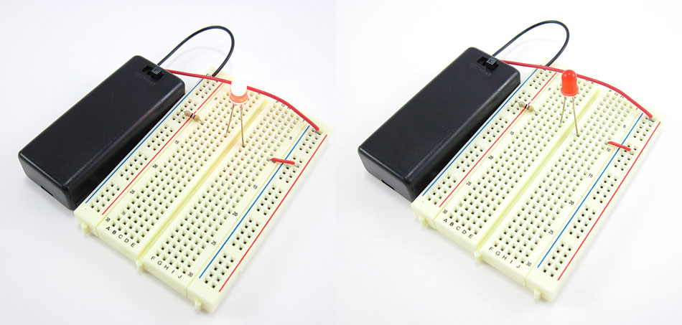

Slide 12
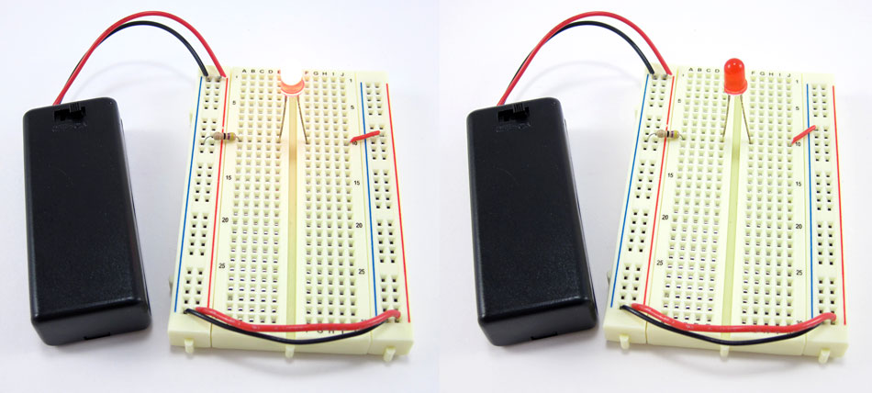

Slide 13
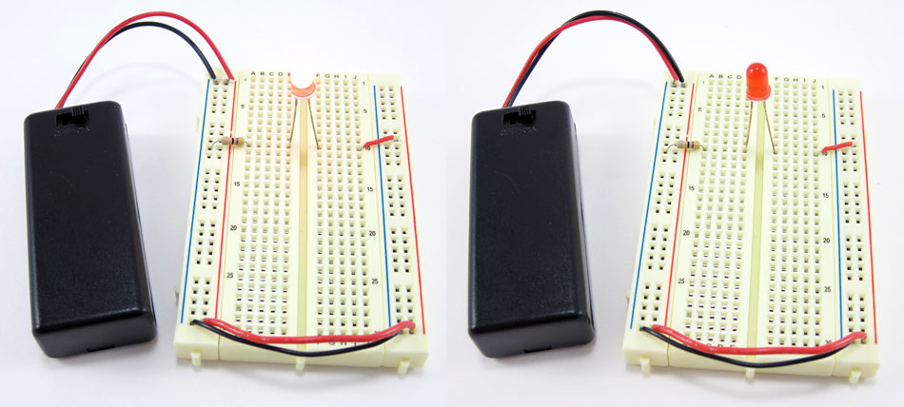

Slide 14
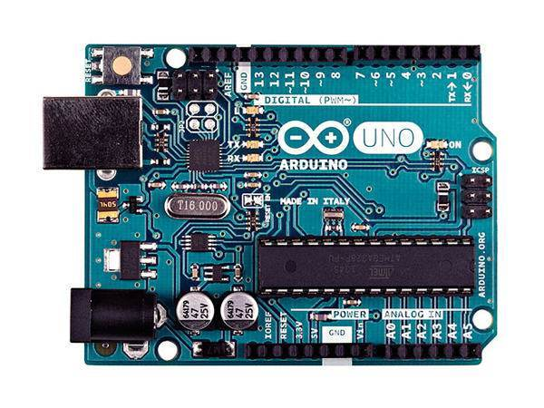
Topic 2 Arduino Uno —— Highly Integrated Development Board
Reset Button
Digital Input/Output
USB wire port——
for uploading programs
Power Output
DC Input
Analog Input
Notes:
Digital input / output
Analog input / output

Slide 15
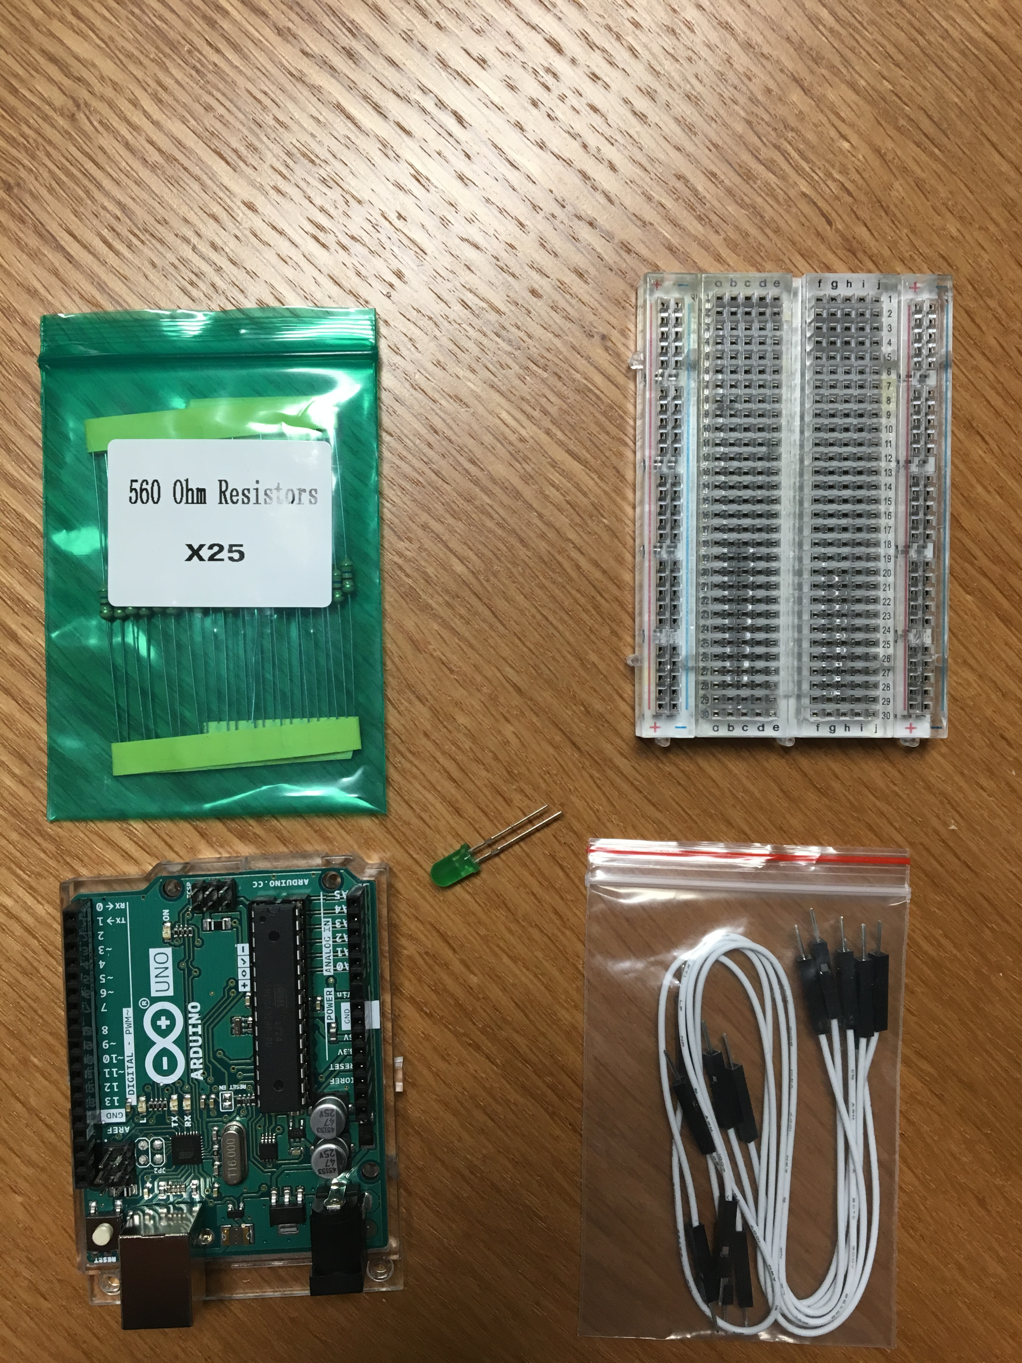
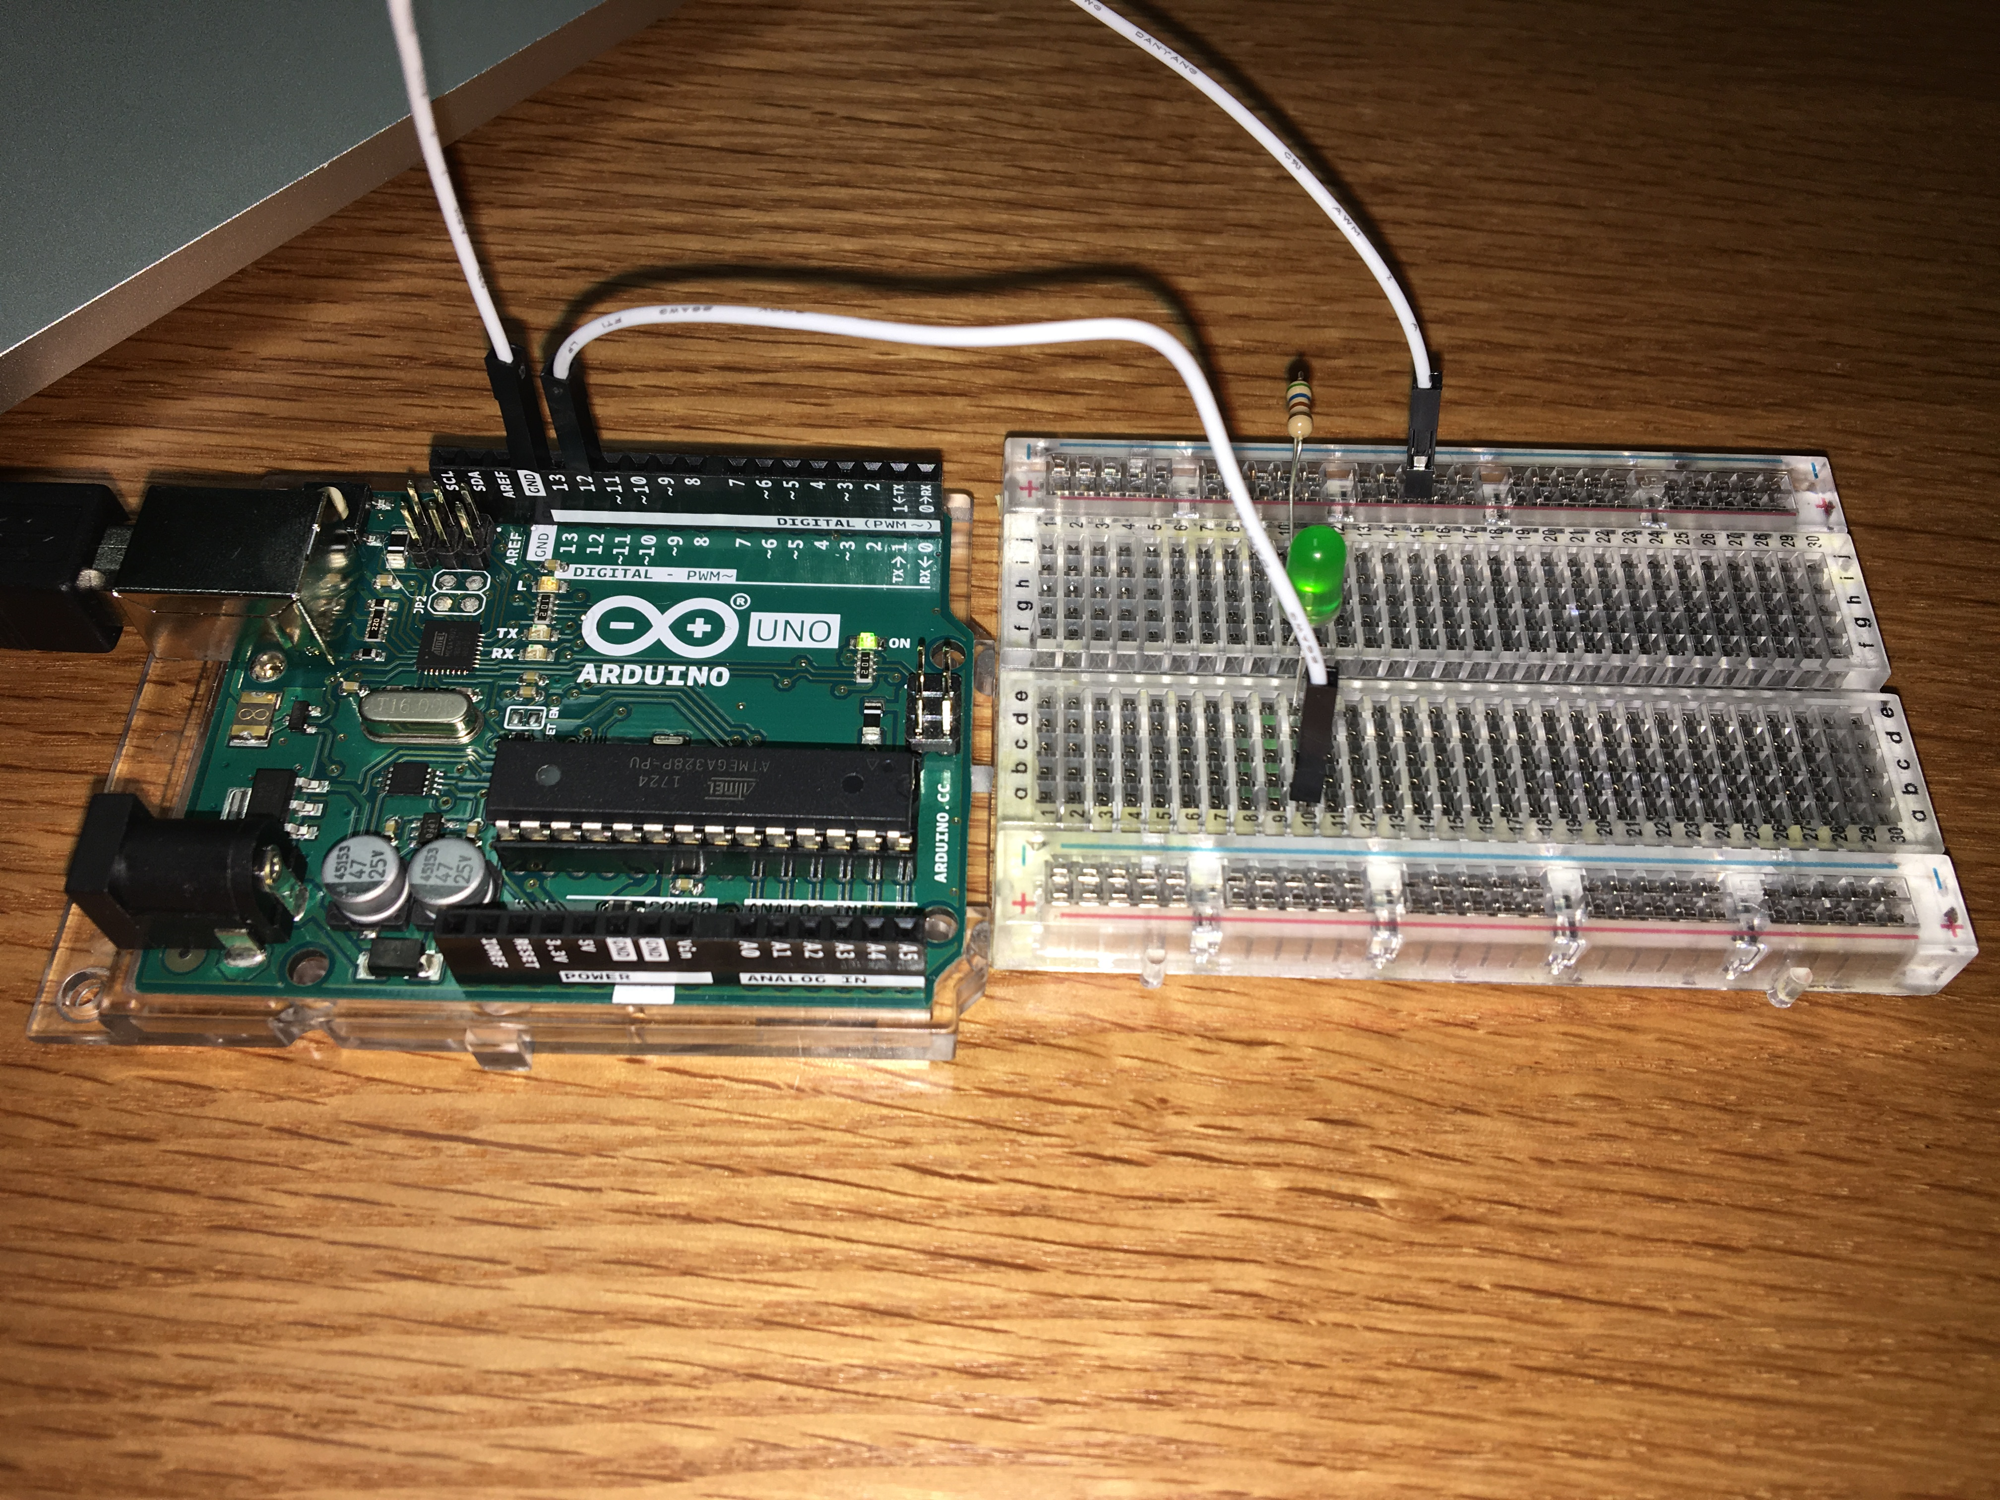
First Arduino Program: Blink
Materials
Breadboard x 1
560 ohm resistor x 1
10 mm LED x 1
Jumper Wires x n
Arduino Uno Board
Actual Wire Connection

Slide 16
Topic 3 Arduino Code
Arduino Code is written with C language
Following the syntax as well as the style of C
For students who have learned Python, Arduino code is really easy with some simple documentation reading
For students who do not have any programing experience, then you may need a really hard work to follow
Good Chinese Resource to learn Arduino Code:
Arduino 函数参考：https://arduino-wiki.clz.me/?file=home-%E9%A6%96%E9%A1%B5
Arduino 编程基础：https://www.arduino.cn/thread-45048-1-1.html
English Version Resources to learn Arduino Code:
http://forefront.io/a/beginners-guide-to-arduino/
https://www.youtube.com/watch?v=AJkEQ9t4WfY

Slide 17
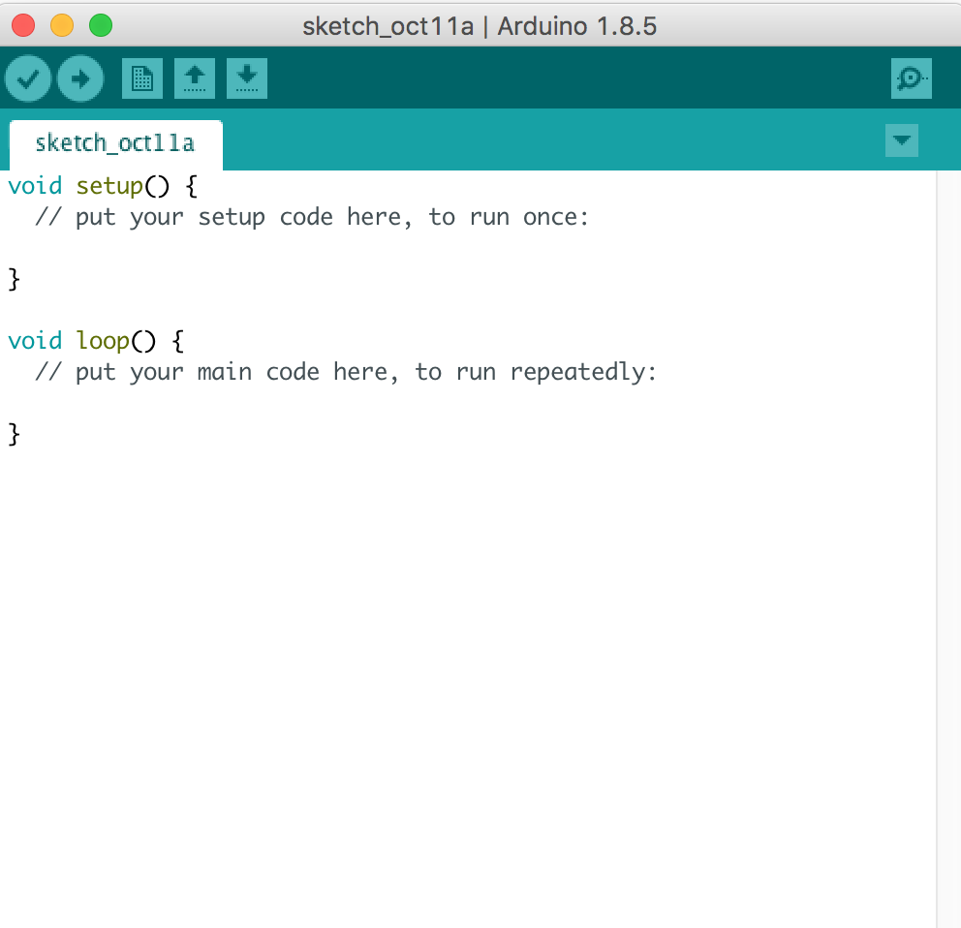
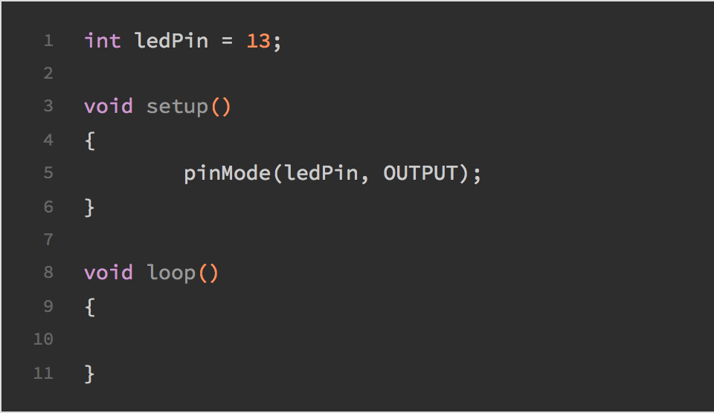
Topic 3 Arduino Code: Structure (Boring but Important)
‘Void’ function does not return any value!!!
Void Setup()
Only run once right after the Arduino works
Void loop()
Functions of Arduino code
Loop infinitely as long as not powered-off
死循环： 执行到断电为止
User-defined Function()
Customize your own function for your specific need
How to control the pin output in the program?
Activate specific pin in the code:
PinMode( integer, output/input) integer = pin number on Arduino Board
AnalogWrite(integer, num); num ∈ (0 – 255); 0 ≡ 0 volt output & 255 ≡ 5v output
DigitalWrite(integer, HIGH/LOW)
Pay attention to the reserved words in the Arduino syntax:
e.g.: setup, loop, LED_BUILTIN, HIGH, LOW, delay, pinMode, AnalogWrite…

Slide 18

Arduino Code Syntax

Slide 19
First Arduino Experiment: Blink
Program the Arduino Board, set the LED light to be ON
Program the Arduino Board, set the LED light to be OFF
What about setting the LED light on and off, regularly?
hint: use the delay() function in Arduino
Function: delay(X) X is an integer
keep executing the last line of code for X milliseconds
After you finish those steps:
What about changing the active pin number? Try different pin outputs and explore them.
What about setting the LED light on and off with different
delay times? Check at which threshold human eye fails
to identify the blinking of the LED lights? (把delay time减小到
哪一个临界点，人眼就看不见灯的闪烁？)
Fading of the lights:
How to write the code so as to make the brightness of the LED go up gradually, then fades?
Using the PWM modulation: linear increment/decrement of voltage output can change the brightness gradually.

